Slide 1
Nutrients

Slide 2
Nutrients
Food is eaten and digested in the body to allow the absorption of energy and nutrients.
There are two different types of nutrients:
macronutrients;
micronutrients.
There are three macronutrients that are essential for health.
These are:
carbohydrate;
protein;
fat.
Macronutrients are measured in grams (g).

Slide 3
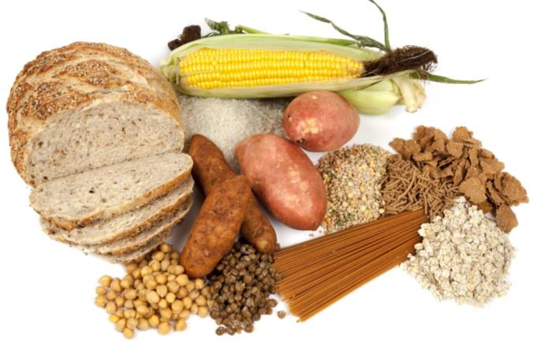
Carbohydrate
The two main types of carbohydrate that provide dietary energy are starch and sugars. Dietary fibre is also a type of carbohydrate.
Starchy carbohydrate is an important source of energy.
One gram of carbohydrate provides 3.75kcal/16kJ energy.
One gram of fibre provides 2kcal/8kJ energy.

Slide 4
Structure of carbohydrate
All types of carbohydrate are compounds of carbon, hydrogen and oxygen.
They can be classified in many different ways. One common way is according to their structure.
Sugars
Sugars come from a variety of foods. Some are within the cellular structure of the food, e.g. in fruit or vegetables. These are called intrinsic sugars.
Other sugars are not bound into the cellular structure of the food, e.g. in milk or honey. These are called extrinsic sugars.

Slide 5
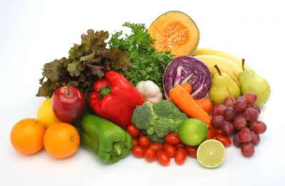
Sources of sugar
Can you give some examples of sources of sugar in the diet?
fruit and vegetables (fructose);
milk and dairy products (lactose);
honey;
fruit juice;
table sugar (sucrose);
sweets and chocolate.

Slide 6
Starchy carbohydrate
Starch is found in a variety of foods. It is made up of many sugar molecules.
Can you give some examples of sources of starch in the diet?
Potatoes
Bread
Rice
Pasta
Cereal and cereal products are the main source of carbohydrate for adults in the UK.

Slide 7
Protein
Protein is essential for growth and repair and keeping cells healthy.
Protein also provides energy:
1 gram of protein provides 4 kcal (17 kJ).

Slide 8
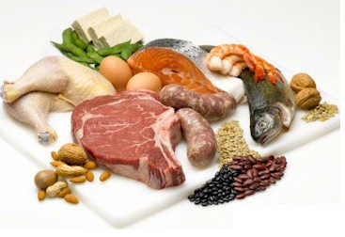
Structure of protein
Protein is made up of building blocks called amino acids. Different foods contain different amounts and different combinations of amino acids.
Protein from animal sources (e.g. meat, fish, eggs and dairy products) contains the full range of essential amino acids needed by the body.
Protein from plant sources (e.g. pulses and cereals) typically contain fewer essential amino acids.

Slide 9
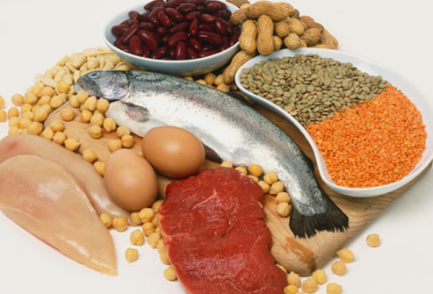
Sources of protein
Animal:
meat;
fish;
eggs;
milk;
cheese.
Plant:
nuts;
seeds;
pulses, e.g. beans, lentils;
mycoprotein;
soya products.

Slide 10
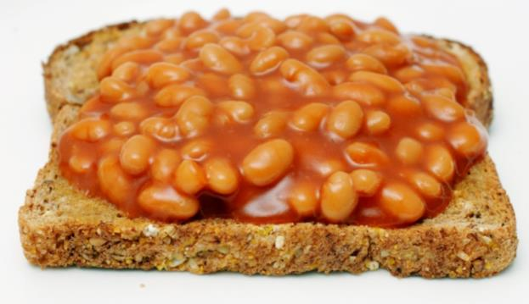
Protein sources
Eating different types of protein can ensure sufficient intake of essential amino acids which are needed by the body.
Name some examples of dishes which combine protein from different sources.
For example:
Baked beans on wholegrain toast.
Breakfast cereal with milk.
Cottage pie with vegetables.
Hummus and salad wrap.
Fish pie and peas.
Spinach and chickpea curry with rice.

Slide 11
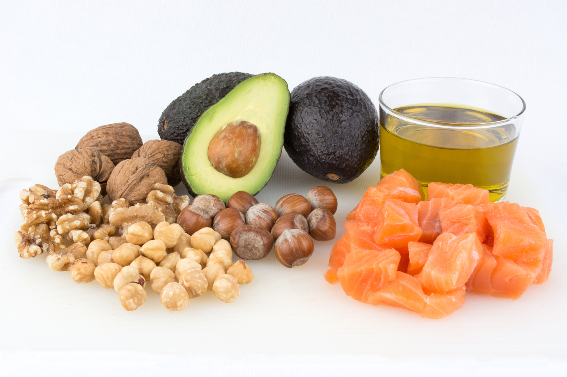
Fat
Fat provides fat-soluble vitamins A, D, E and K, and is necessary for their absorption. It is also important for essential fatty acids the body cannot make.
Fat provides a concentrated source of energy:
1 gram of fat provides 9 kcal (37 kJ) of energy.
Foods that contain a lot of fat provide a lot of energy.

Slide 12
Structure of fat
Fat is made up of different types of fatty acids and glycerol.
The structure of the fatty acids determines:
their effect on our health;
their characteristics, e.g. melting point.

Slide 13
Structure of fat
Depending on their chemical structure, fatty acids are usually classified as:
saturated;
monounsaturated;
polyunsaturated.
There is strong and consistent evidence that replacing saturated fatty acids with unsaturated fatty acids reduces the risk of CVD events and can help lower cholesterol.

Slide 14
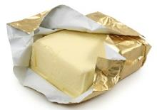
Fatty acids
All foods provide different types of fatty acids in varying proportions.
Butter is often described as a ‘saturated fat’ because it has more saturated fatty acids than unsaturated fatty acids.
Most vegetable oils are described as ‘unsaturated fats’ as they have more mono and polyunsaturated fatty acids than saturated.

Slide 15
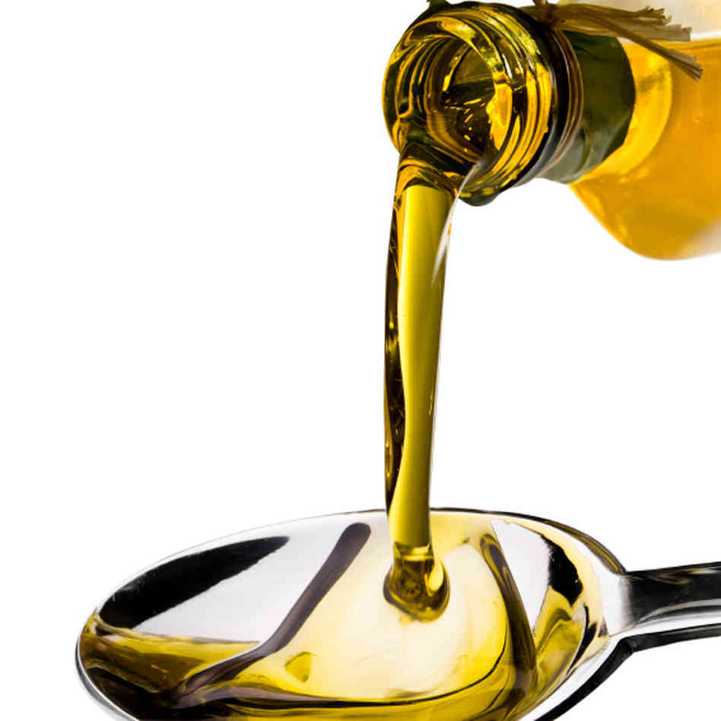
Saturated and unsaturated fatty acids
Most saturated fats are solid at room temperature and tend to come from animal sources.
Some plant sources such as palm oil and coconut oil also have high levels of saturated fat.
Most unsaturated fats are liquid at room temperature and are usually from plant sources.
Oily fish is also high in long chain omega-3 fatty acids.

Slide 16
Micronutrients
There are two types of micronutrients:
vitamins;
minerals.
Vitamins and minerals are needed in much smaller amounts than macronutrients. Their amounts are measured in milligrams (mg) and micrograms (μg).
(1mg = 0.001g)
(1μg = 0.001mg).

Slide 17
Vitamins
There are two groups of vitamins:
fat-soluble vitamins, which can be stored in the body, e.g. vitamins A and D.
water-soluble vitamins, which cannot be stored in the body and are therefore required daily, e.g. B vitamins and vitamin C.

Slide 18
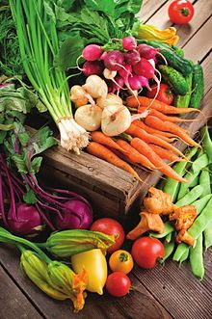
Fat soluble vitamins
Vitamin A is needed for:
dim light vision;
healthy skin and eyes;
resistance to infection.
Vitamin A is found pre-formed in liver and whole milk. It can also be produced from beta-carotene provided by dark green leafy vegetables, carrots and orange coloured fruit.
In the UK, margarine must be fortified with vitamin A and vitamin D. Vitamin A and D are also often voluntarily added to reduced fat spreads.

Slide 19
Vitamin D
Vitamin D is needed for the absorption of calcium from foods to keep bones and teeth healthy.
A lack of vitamin D causes rickets in children, where the legs are bent, and osteomalacia in adults, which causes pain in bones and muscles.
We get most of our vitamin D via the action of sunlight on skin during the summer months. Vitamin D is also provided by the diet from oily fish, meat, eggs, fortified breakfast cereals and margarine/spreads.

Slide 20
Water soluble vitamins
There are many different B vitamins and each has a specific function in the body.
These include:
vitamin B₁ (Thiamin);
vitamin B₂ (Riboflavin);
vitamin B₃ (Niacin);
vitamin B₆;
vitamin B₁₂;
folate/folic acid.

Slide 21
Thiamin (vitamin B₁)
Thiamin is required to release energy from carbohydrate.
It is also involved in the normal function of the nervous system.

Slide 22
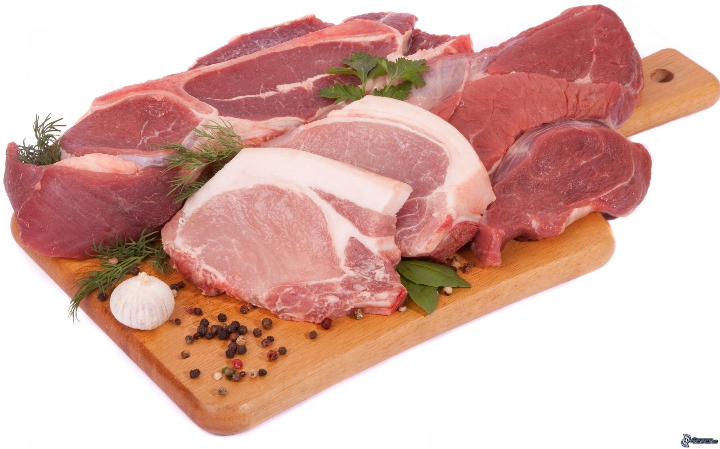
Sources of Thiamin (vitamin B₁)
Sources of Thiamin (vitamin B₁):
whole grains;
nuts;
meat (especially pork);
fruit and vegetables;
fortified breakfast cereals.
Did you know?
In the UK, white and brown bread flour are fortified with thiamin by law (and also with calcium, iron and niacin).

Slide 23
Riboflavin (vitamin B₂)
Riboflavin is required to release energy from protein, carbohydrate and fat.
It is also involved in the transport and use of iron in the body.

Slide 24
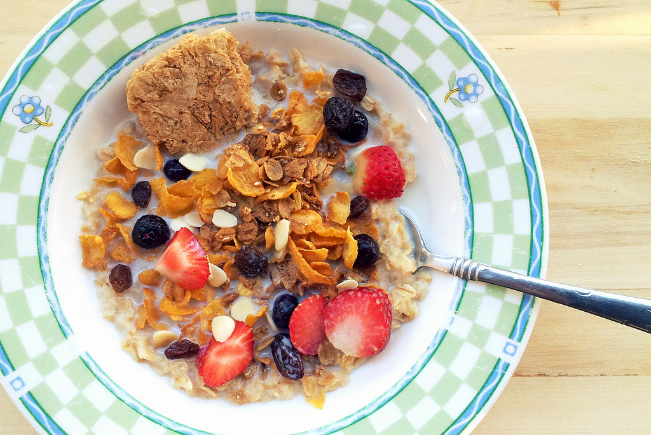
Sources of Riboflavin (vitamin B₂)
Sources of Riboflavin (vitamin B₂):
milk;
eggs;
rice;
fortified breakfast cereals;
liver;
legumes;
mushrooms;
green vegetables.
Did you know?
Legumes are the fruits or seeds of anything that comes in a pod, e.g. beans, peas, lentils.

Slide 25
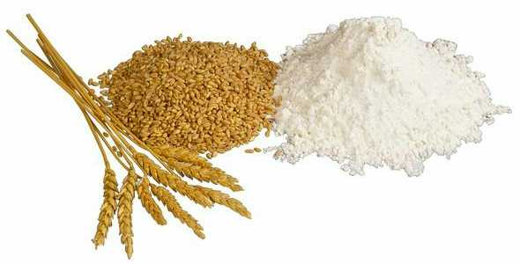
Niacin (Vitamin B₃)
Niacin is required for the release of energy from food.
Niacin is also required for the normal function of the skin, mucous membranes and nervous system.
Sources of Niacin:
meat;
wheat and maize flour;
eggs;
dairy products;
yeast.

Slide 26
Vitamin C
Vitamin C is needed to make collagen. This is required for the structure and function of skin, cartilage and bones.
It is an important nutrient for healing cuts and wounds.
Did you know?
Vitamin C can help with the absorption of iron when foods or drink containing both vitamin C and iron are eaten at the same meal.

Slide 27
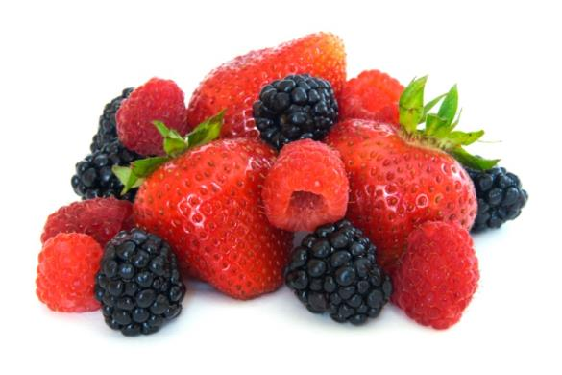
Sources of vitamin C
Sources of vitamin C:
Fresh fruit especially citrus fruits and berries.
Green vegetables.
Peppers.
Tomatoes.
New potatoes.
Can you name some citrus fruit?
Lime, orange, grapefruit, tangerine, lemon, clementine.
How many different types of berries can you think of?
Blackberries, blackcurrants, strawberries, raspberries , blueberries, cranberries.

Slide 28
Minerals
Minerals are inorganic substances required by the body in small amounts for a variety of different functions.
The body requires different amounts of each mineral.
People have different requirements, according to their:
age;
gender;
physiological state (e.g. pregnancy).

Slide 29
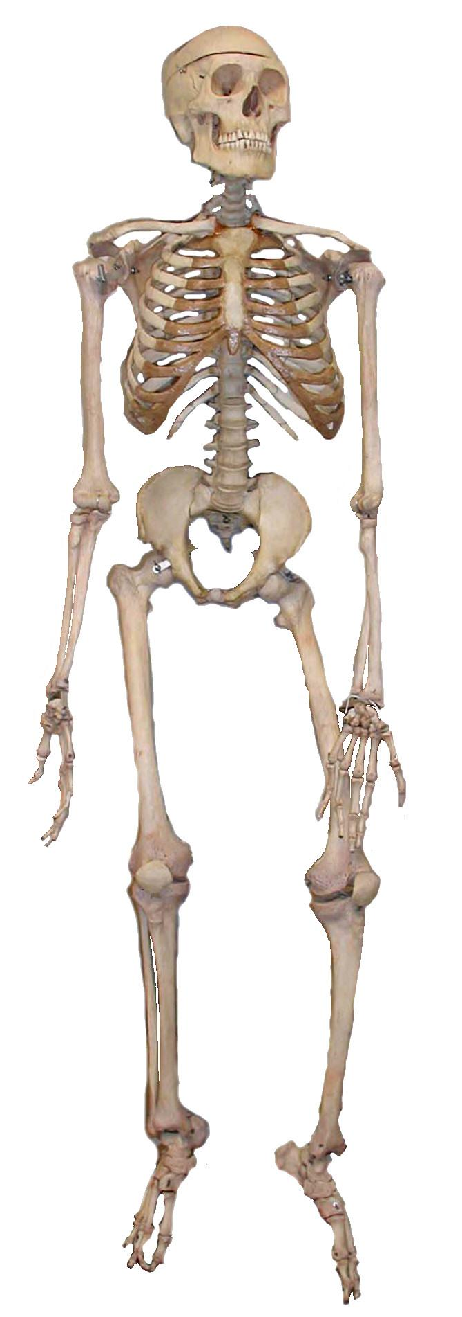
Calcium
The body contains more calcium than any other mineral. It is essential for a number of important functions such as the maintenance of bones and teeth, blood clotting and normal muscle function.
Did you know?
The skeleton contains about 99% of the body’s calcium with approximately 1kg present in adult bones.

Slide 30
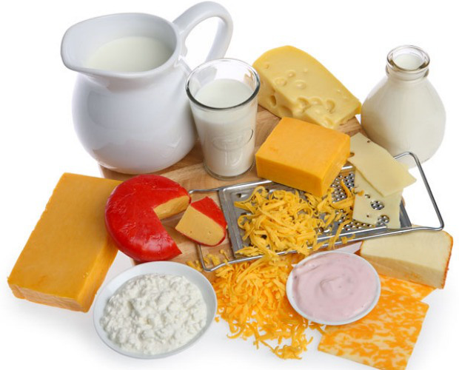
Sources of calcium
Milk, cheese and other dairy products provide about half of the calcium in the UK diet.
Bread is also a source of calcium in the UK because white and brown flour is fortified with calcium by law.
Calcium is also provided by:
broccoli;
cabbage;
fortified soya products;
fish eaten with the bones, e.g. sardines, tinned salmon and
whitebait.

Slide 31
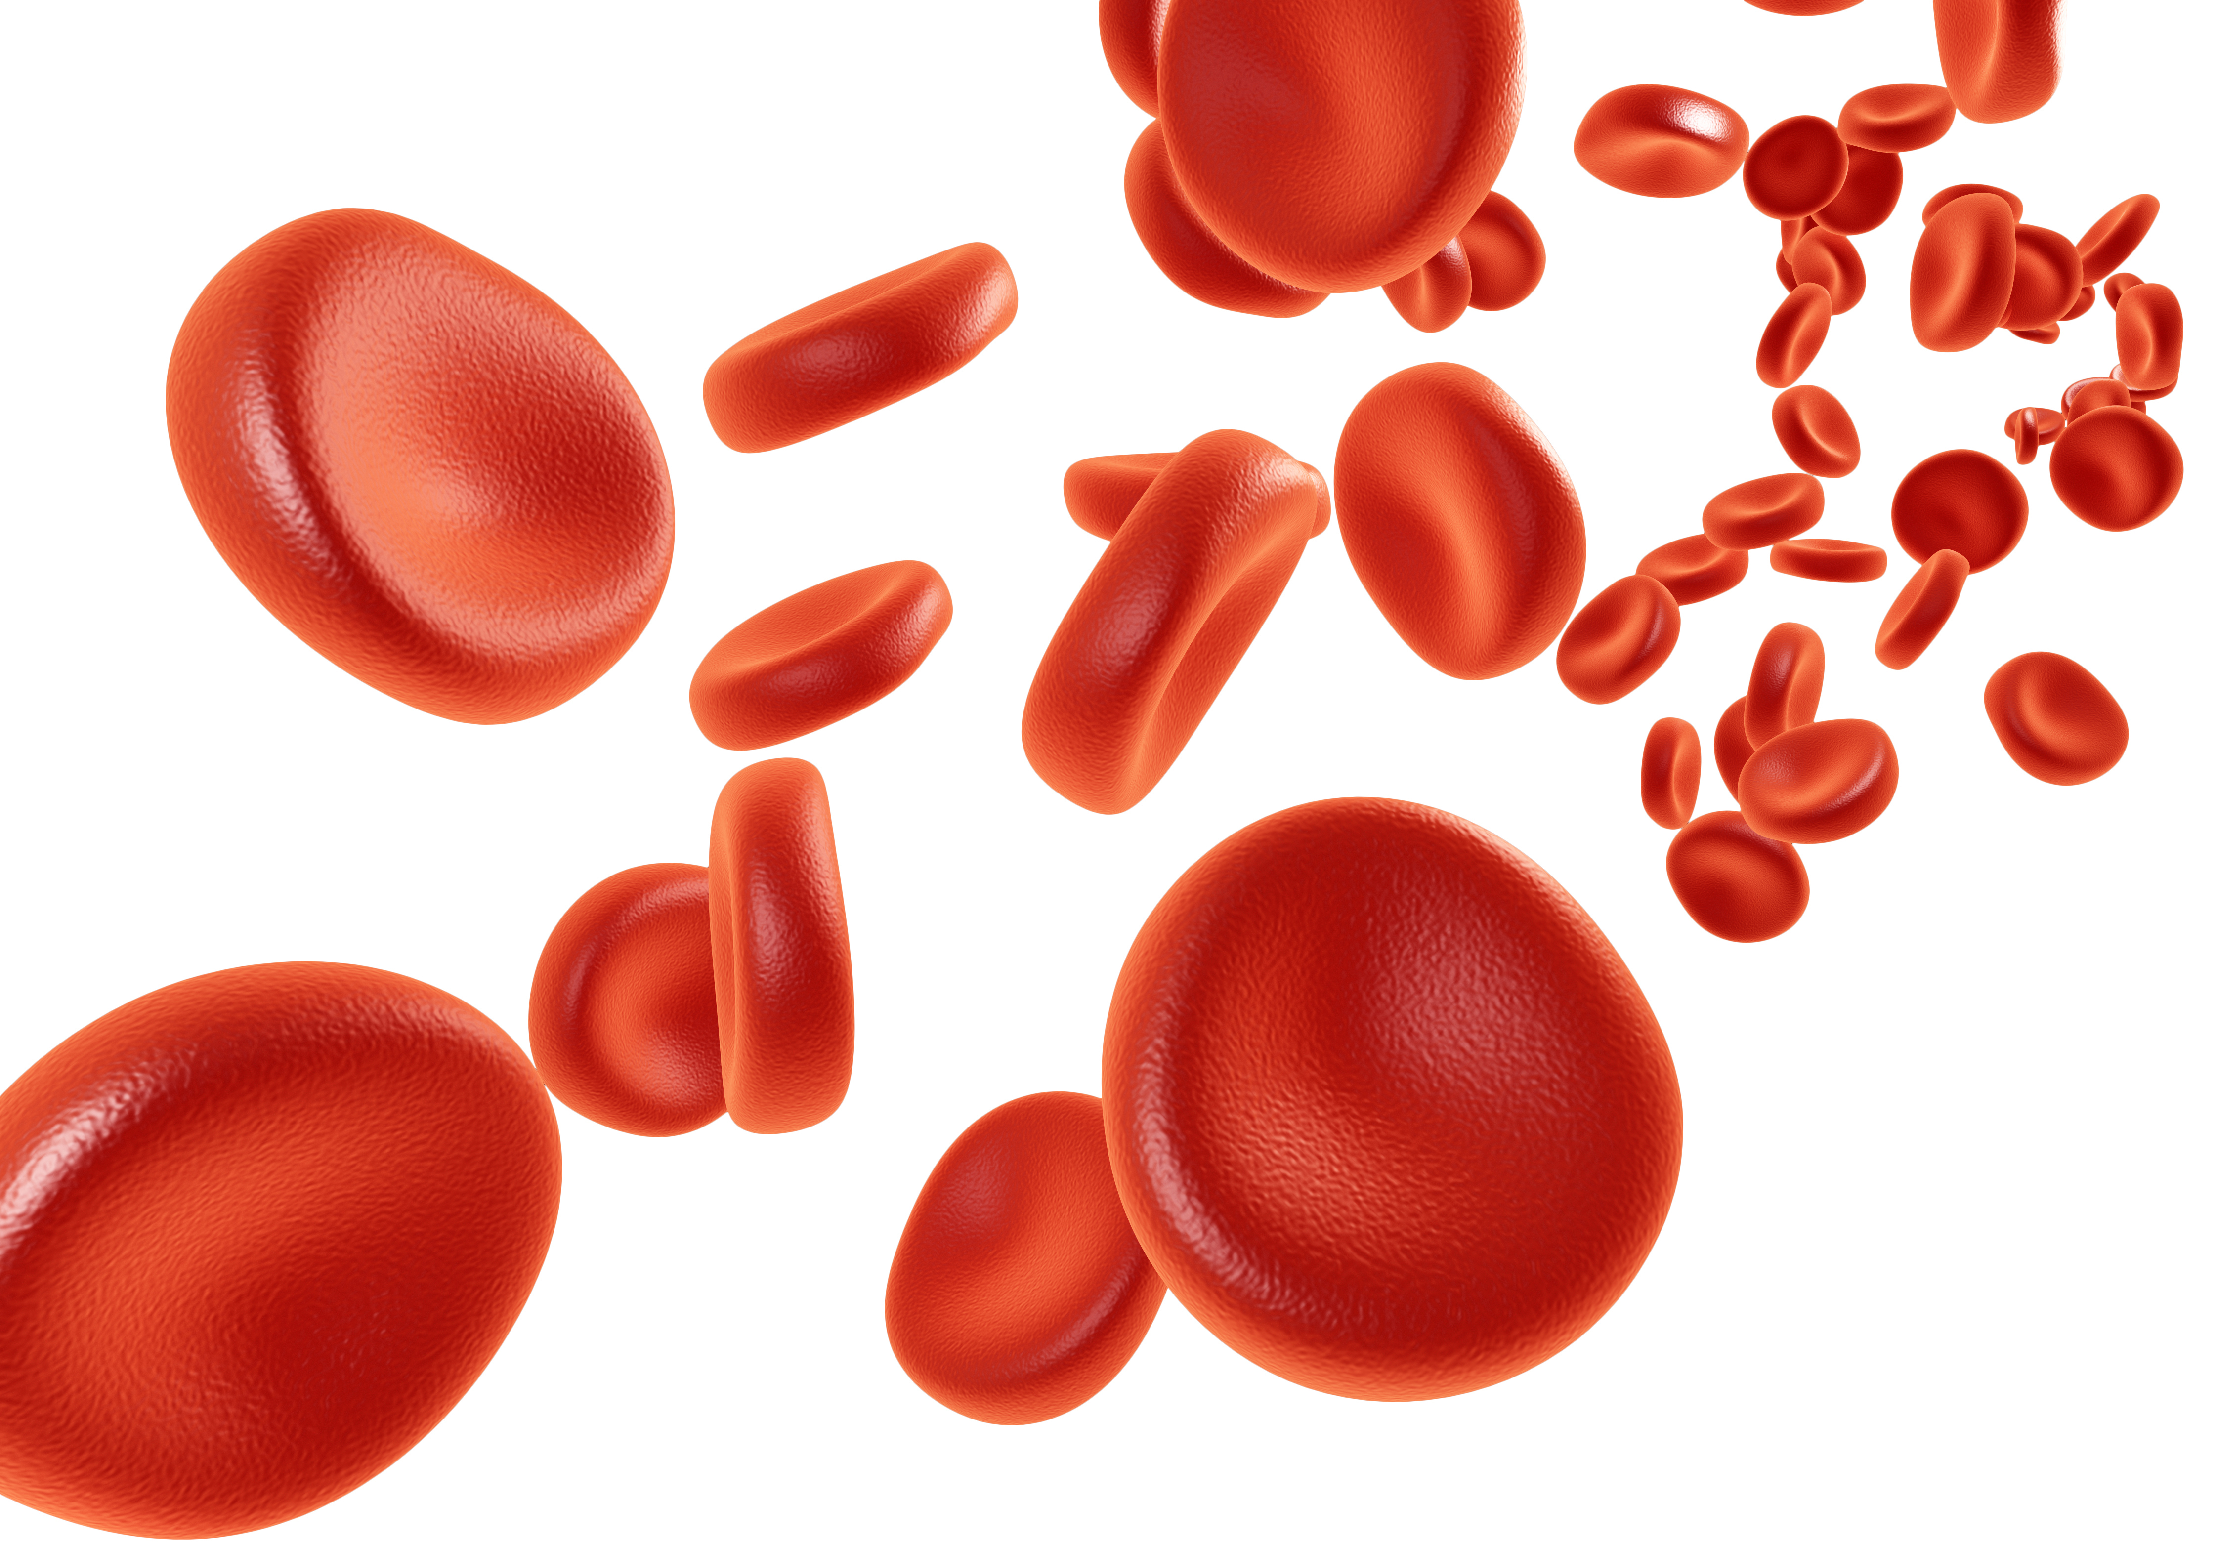
Iron
Iron is essential for the formation of haemoglobin in red blood cells.
Red blood cells carry oxygen and transport it around the body.
Iron is also required for the normal functioning of the immune system and in the reduction of tiredness and fatigue.
Did you know?
There are two types of iron; one from animals sources and the other from plant sources.

Slide 32
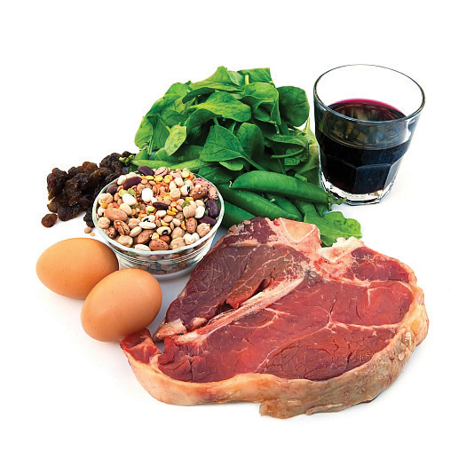
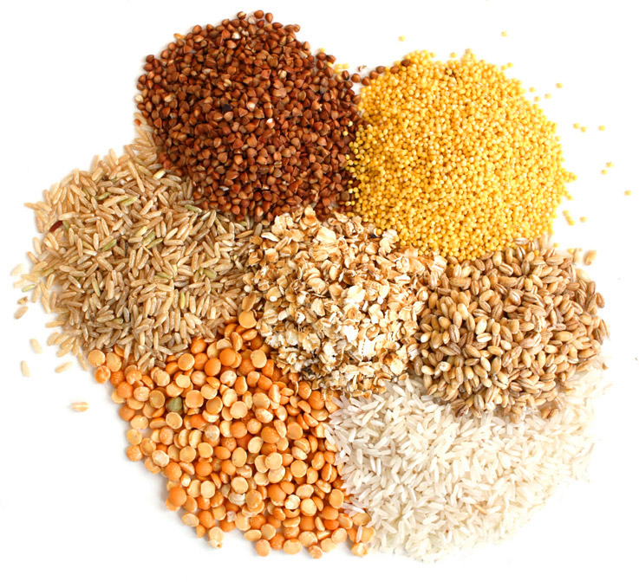
Sources of iron
Sources of iron include:
Liver;
Red meat;
Pulses;
Nuts;
Eggs;
Dried fruits;
Fish;
Whole grains;
Dark green leafy vegetables.

Slide 33
Iron in the diet
A lack of iron in the diet means that the stores in the body will run out. This can lead to anemia.
Women and teenage girls need to ensure they have enough because their requirements are higher than those of men of the same age due to menstruation.
Did you know?
More than 2 billion people worldwide suffer from iron deficiency anaemia, making it the most common nutritional deficiency.

Slide 34
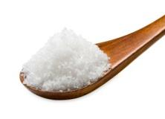
Sodium
Sodium is found in all cells and body fluids.
It is needed for regulating the amount of water and other substances in the body.
Did you know?
Sodium is a component of table salt, known as sodium chloride (NaCl).

Slide 35
Sources of sodium
Most raw foods contain very small amounts of sodium chloride (salt).
Salt is often added during the processing, preparation, preservation and serving of foods.
About 20% of salt we eat is added at home during cooking and at the table.
How can we reduce salt when preparing and cooking food?

Slide 36
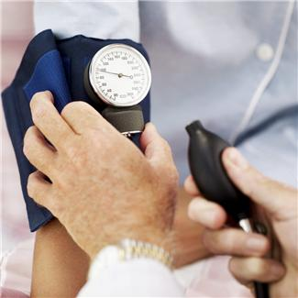
Sodium in the diet
Sodium intakes in the UK are considered to be too high. It is unlikely that we would lack sodium.
High sodium intake is considered to be one of the risk factors for high blood pressure, which may lead to heart disease and stroke.
Did you know?
It is recommended that adults and children 11 years and over not to have more than 6g of salt per day. Young children should eat less.

Slide 37
Summary
Macronutrients include carbohydrate, protein and fat. These provide energy and are needed in large amounts.
Micronutrients include vitamins and minerals. These do not provide energy but are essential for health.

Slide 38
Quiz - Kahoot
Open the link below on the main screen and get students to log onto kahoot.it on their tablets or smartphones.
They can then enter the code (that will come up on the main screen when you start the game) and their own nickname.
They can then play along with the quiz choosing the multiple choice answers that correspond with the questions on the main screen. There will then be a leaderboard of the scores after each question and at the end.
https://create.kahoot.it/share/nutrients/fb67ce7b-ce4b-46fd-b843-5b3d026e0330

Slide 39
Nutrients
For further information, go to:
www.foodafactoflife.org.uk

