Slide 1
Healthy Eating Workshop
BACE holidays

Slide 2
Learning Objectives
-Why it is important to eat healthy -The Eatwell Guide recommendations, including what food groups provide what nutrients -How to select healthy foods -How to make healthy swaps -The best fluids for children -Tips and resources to make healthy eating easier, especially on a tight budget

Slide 3
Benefits
Barriers
Healthy weight
Improves energy and concentration
Mood
Reduces risk of long-term health conditions such as diabetes
A healthy gut
Supports healthy physical growth
Supports the immune system
Financial pressures
Lack of knowledge
Mental Health struggles
Disability
Illness
Cooking facilities
Taste
Notes:
When it comes to promoting healthy eating, it is always good to highlight the benefits and to tailor the message you give out to the target group as much as possible. Just saying do this because it is good for you is often very unhelpful and likely to be ignored. So let’s go over the benefits for the target group in question: HE for children and young people:
Healthy weight (an individual can move around better; protects against health problems)
Improves energy and concentration levels (crucial for learning/academic achievement)
Mood (supports good mental health)
Reduces risk of long-term health conditions such as diabetes (body struggles to control blood sugar levels) and heart disease (fat clogs up in our blood vessels)
A healthy gut (supports good bacteria in the gut that reduce the likelihood of diarrhoea, bloating and constipation)
Supports healthy physical growth (childhood and teenage years are years of rapid growth in height and body cells)
Supports the immune system (a healthy diet provides important nutrients to help the immune system function properly)
With younger children when talking about benefits and barriers the language will of course need to be adapted. For e.g. you can say eating healthy makes you grow strong. It helps your bones and teeth etc.
No let’s look at the barriers. This activity is within the session plan. The purpose of the activity is to highlight that HE is a challenge, even small changes are worth it and can make a big difference.

Slide 4
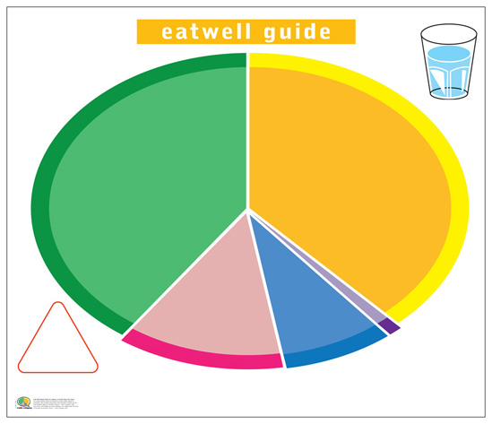

Slide 5
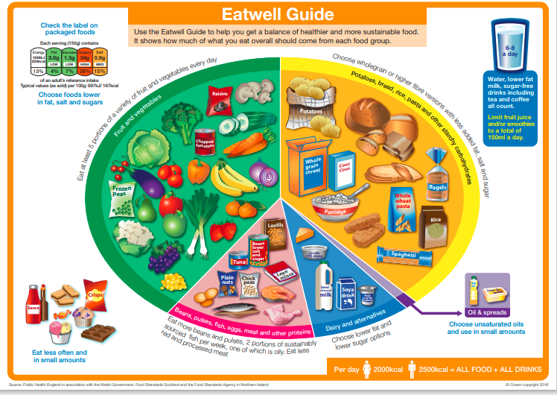

Slide 6
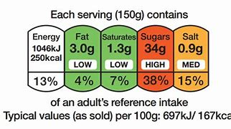
Food labels

Slide 7
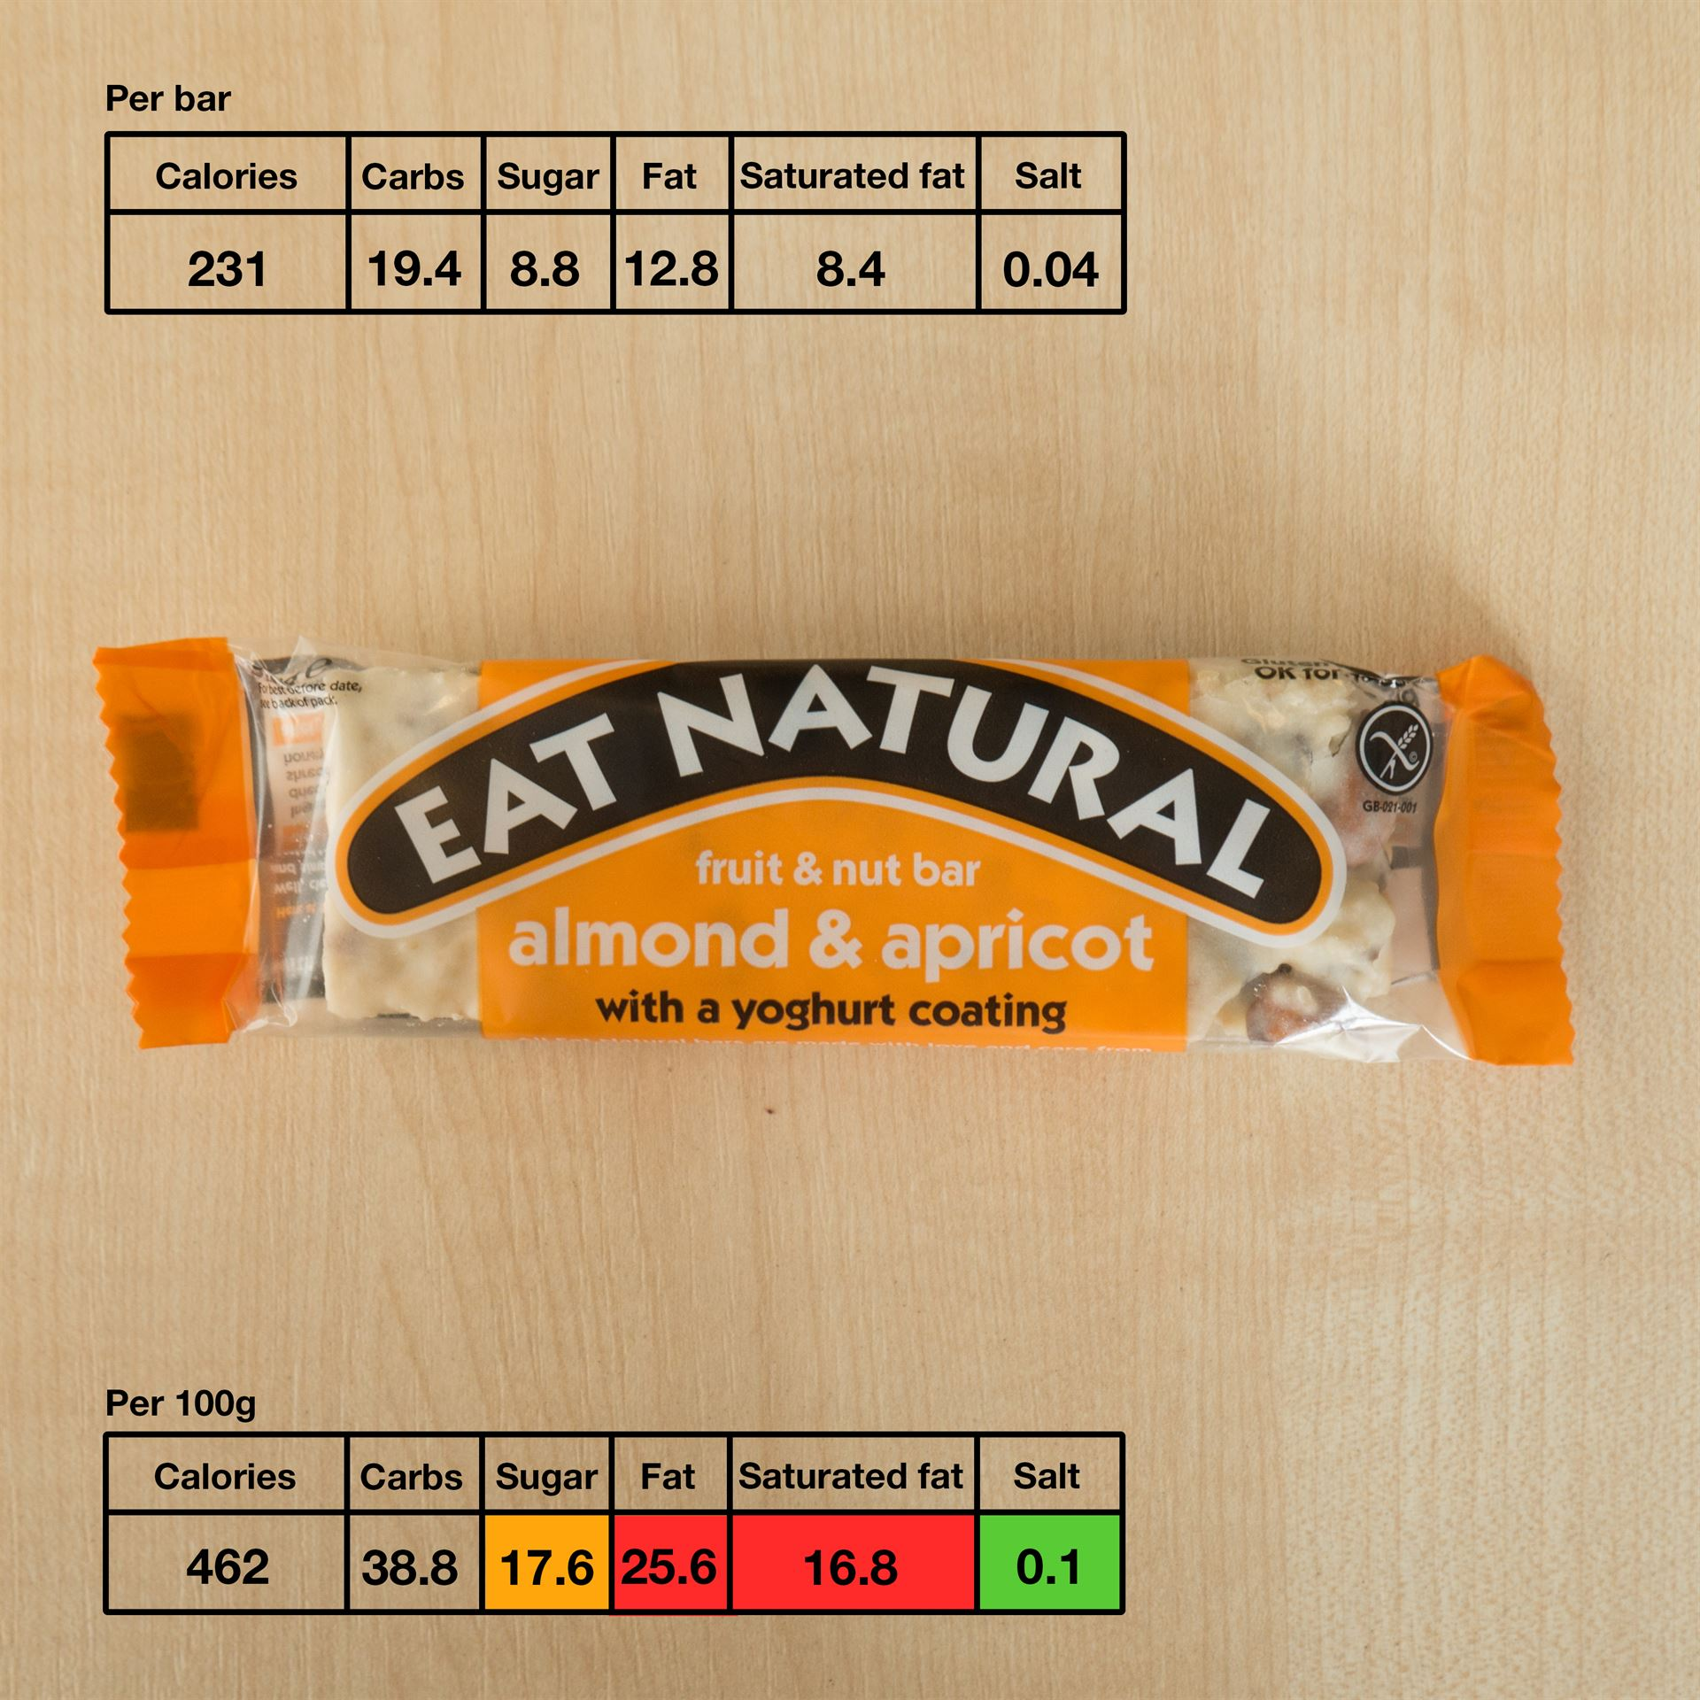
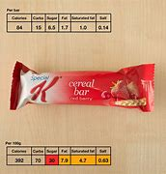
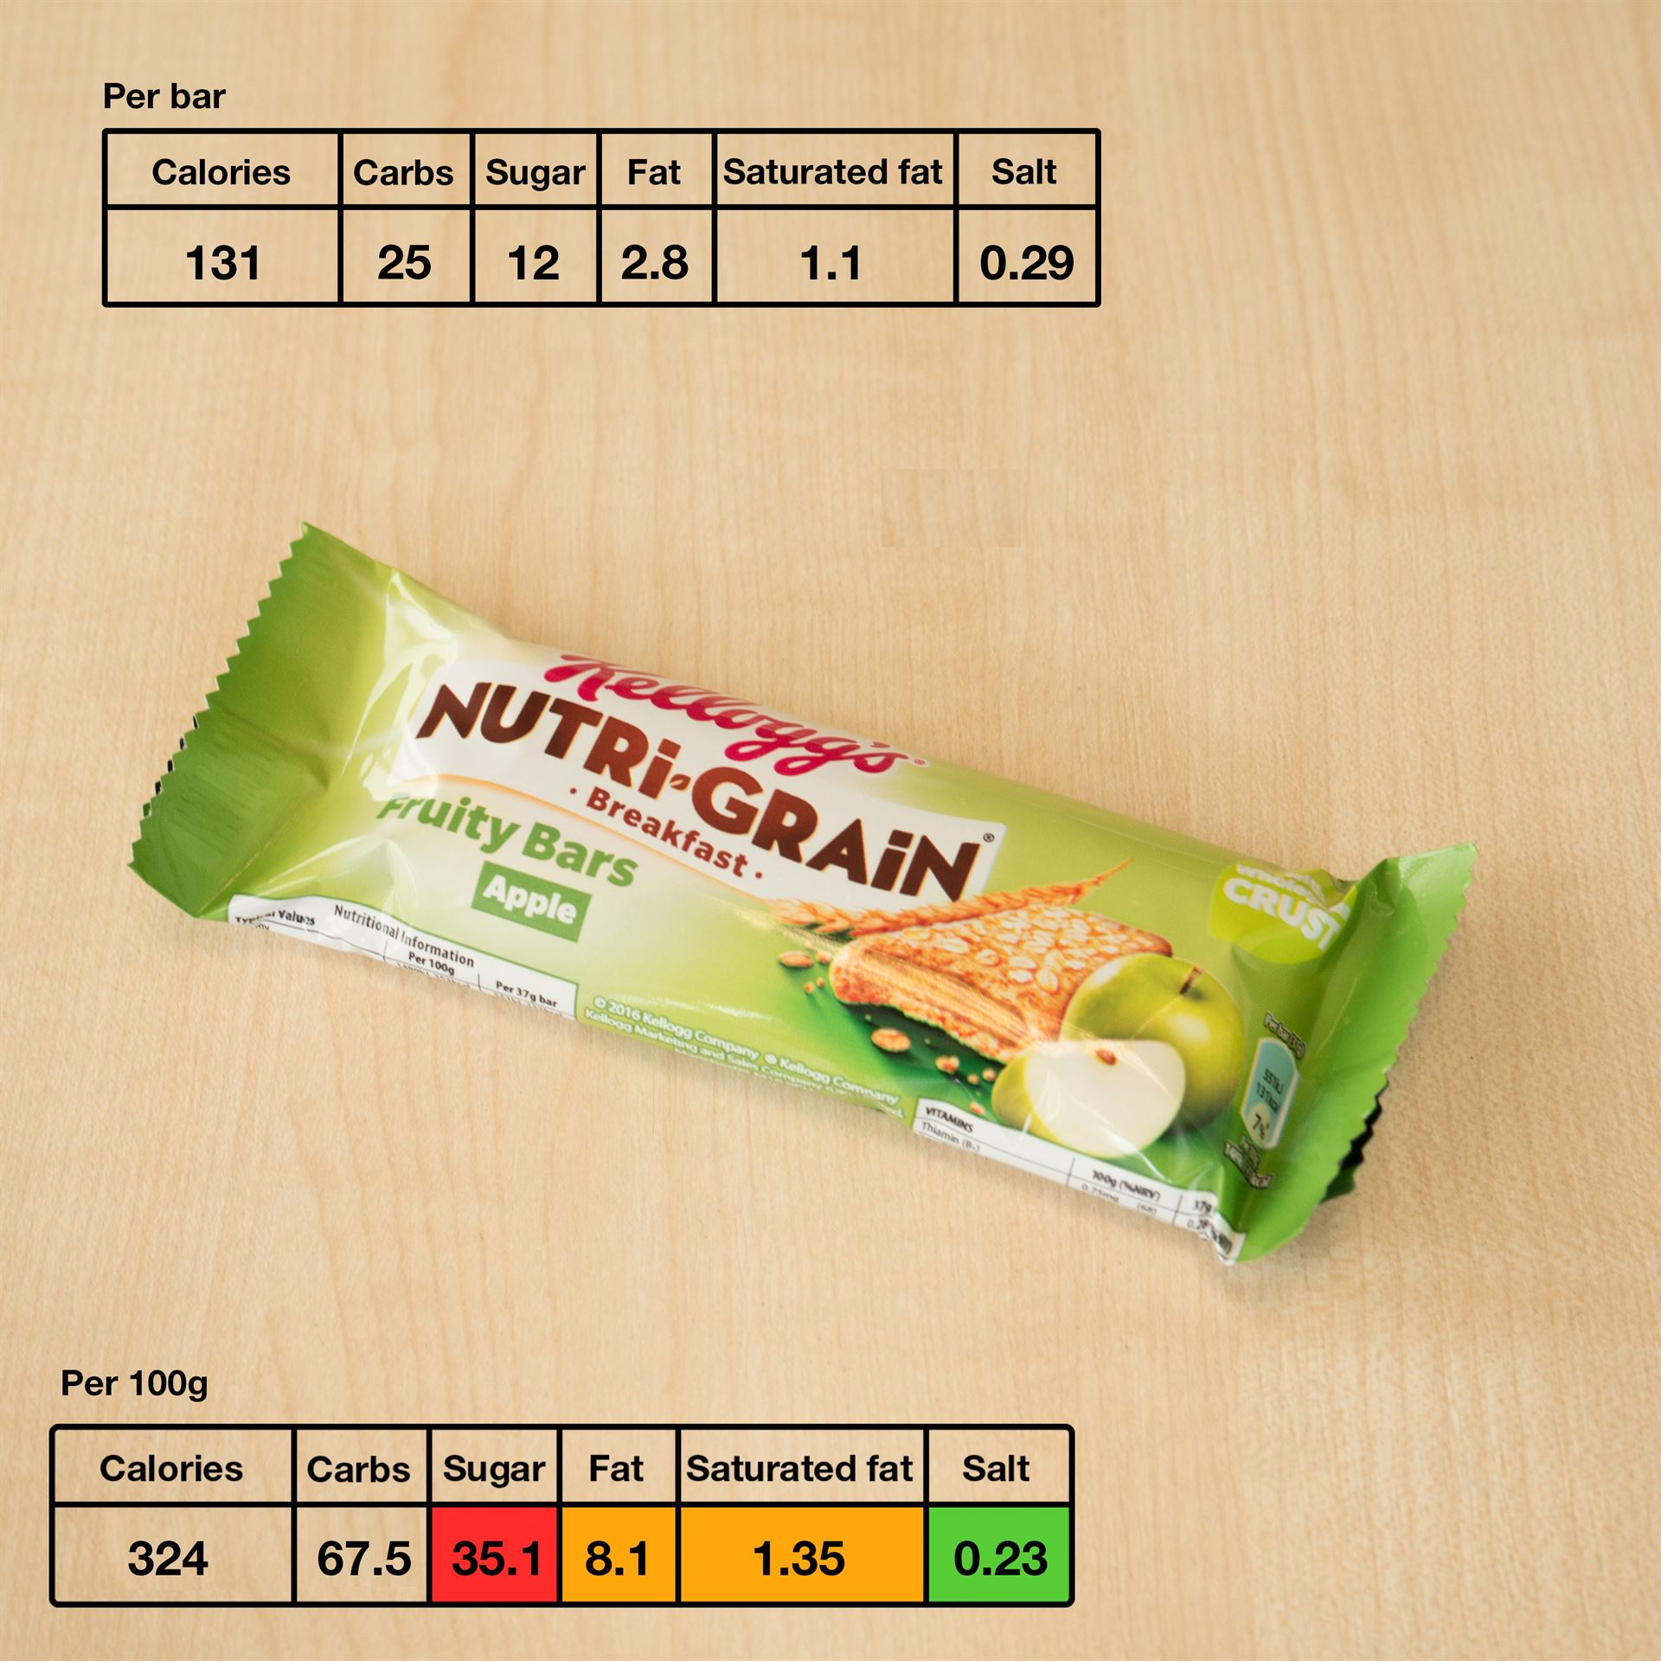
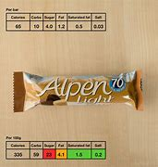
A
C
B
D

Slide 8
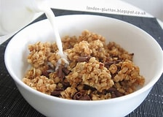
Breakfast

Slide 9
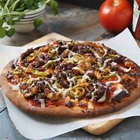
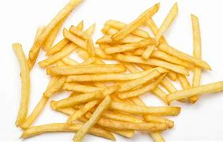
Lunch

Slide 10
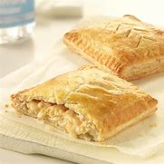
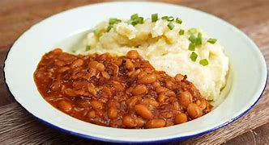
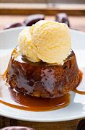
Dinner

Slide 11
Snack

Slide 12
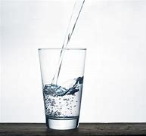
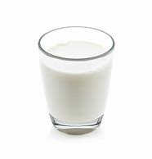
Fluids
Regularly-water, unsweetened Milk (from animal source) or fortified plant-based milks such as oat milk.
Occasionally- heavily diluted juice or no-added sugar squash, unsweetened decaffeinated tea, and coffee.
Avoid- sugary drinks like sports, fizzy and energy drinks. Also, avoid diet drinks.

Slide 13
Try buying frozen and tinned fruits and vegetables as they are much more affordable than fresh varieties and can be kept for longer.
Foods that we often rely on to fill us up are often high in calories but are ‘empty calories. Instead to feel fuller, add more fiber to meals by adding high in fiber foods such as lentils, beans and vegetables. The tinned & frozen versions of these foods are very cheap.
Offering a portion of fruit and vegetable at breakfast and as a snack helps to reach the 5 a day minimum target.
Choose normally expensive foods such as meat and poultry when reduced and freeze in portions.
Top tips

Slide 15
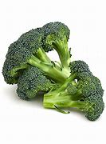
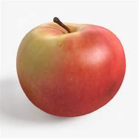
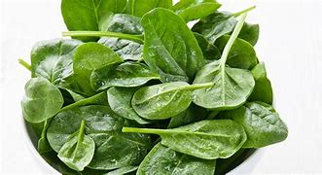

Slide 16
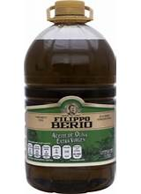
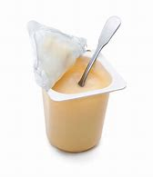
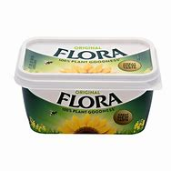
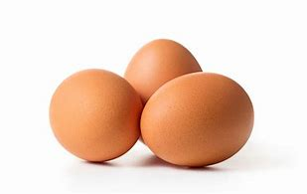

Slide 17
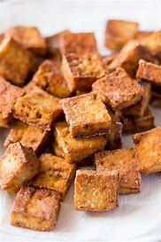
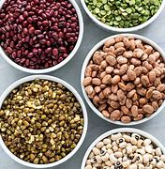
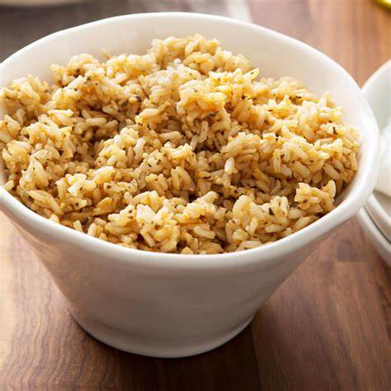
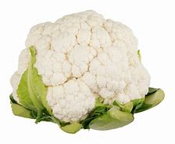

Slide 18
